Slide 1
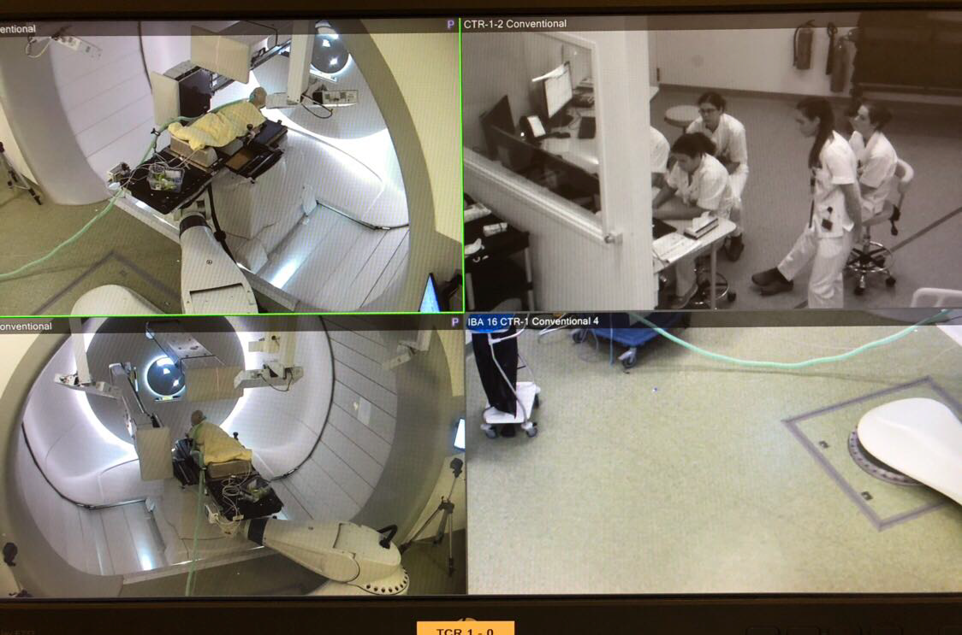
INTEGRATION OF PAEDIATRIC PROTON RADIOTHERAPY SERVICES WITH PAEDIATRIC ANAESTHESIA: THE GRONINGEN EXPERIENCE 1 YEAR ON.
ZA Kostense¹ , JH Maduro², HL van der Weide², B Molenbuur¹
¹Department of Anaesthesia, ²Department of Radiotherapy
University Medical Centre Groningen, The Netherlands
Objectives
We describe the first year experience with integrated paediatric anaesthesia service for children undergoing proton therapy at the Groningen Proton Therapy Centre (GPTC).
Method
This is a retrospective study describing the preparations taken before and the first year experience since the opening of the GPTC in January 2018. The GPTC is the only proton centre in the Netherlands dedicated to paediatric oncology patients. The department of anaesthesia was involved from the beginning of the project and an integral part of the team taking care of the paediatric patients requiring general anaesthesia.
Results
At the start of the project, the department of anaesthesia contributed to the design and layout of the treatment room making it suitable for general anaesthesia in combination with proton radiotherapy. Two focal outcome from the combination team set up were i) in-room induction; and ii) the use of robotic assisted couch. The induction (conduct) of anaesthesia occurs both in the same room as the proton therapy. Once the patient is under general anaesthesia, he or she, is then placed directly on the robotic assisted couch. The two teams (anaesthesia and radiotherapy) then work simultaneously together to ensure the patient received best possible positioning for the proton beams yet remain safe under anaesthesia. This combination allow greater margin for optimal anaesthetic safety without compromising the therapy. The GPTC is also equipped with Post Anaesthetic Care Unit (PACU) and designed to be child-friendly. The safety standards were met in accordance to the Dutch Anaesthetic Association (NVA) including the number of anaesthetic personnel and nursing
Picture 1 The current layout of the GPTC in combination with
general anaesthesia
staff required to conduct the programme. A test run was carried out prior to the start. All paediatric oncology patients in the Netherland referred for proton therapy under general anaesthesia could start their treatment without delay.
Conclusion
Our one year experience has shown that the direct integration and consolidation of paediatric anaesthesia team into the proton centre allowed a smooth delivery of proton therapy in paediatric oncology patients.
Number of patients | 23
Age – mean (range) | 4 (1-15) years
Weight (mean) | 19.4 kg
Gender | Female 65%
 | Male 35%
Tumours treated | Medullablastoma 43%
 | Ependymoma 29%
 | ATRT 8%
 | Ewing sarcoma 8%
 | Medullo-epithelioma 4%
 | Melanoma 4%
 | Rhabdomyosarcoma 4%
Average total fractions per child | 30.9
Table 1 Patient characteristics under GA between 01/03/2018-01/03/2019

