Slide 1
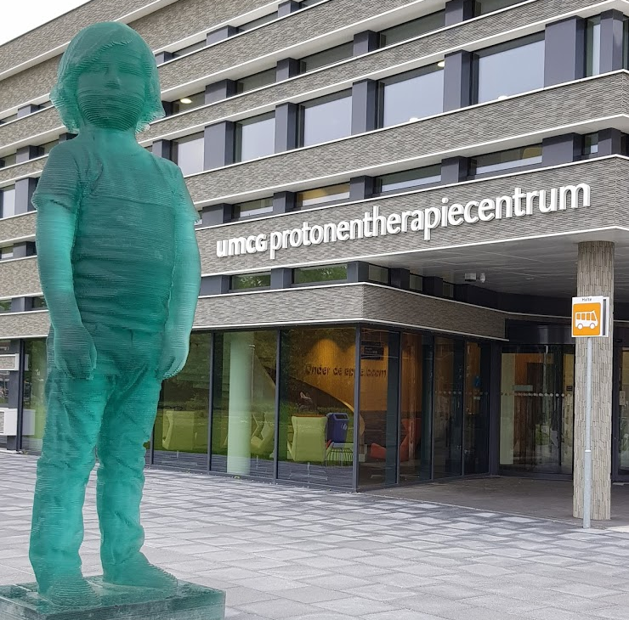
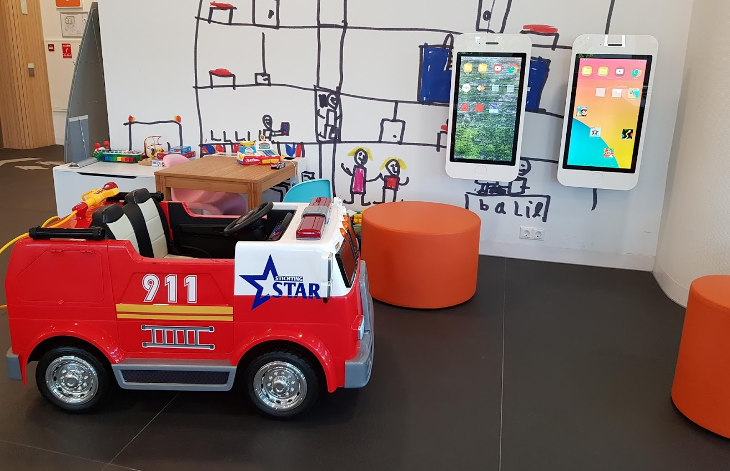
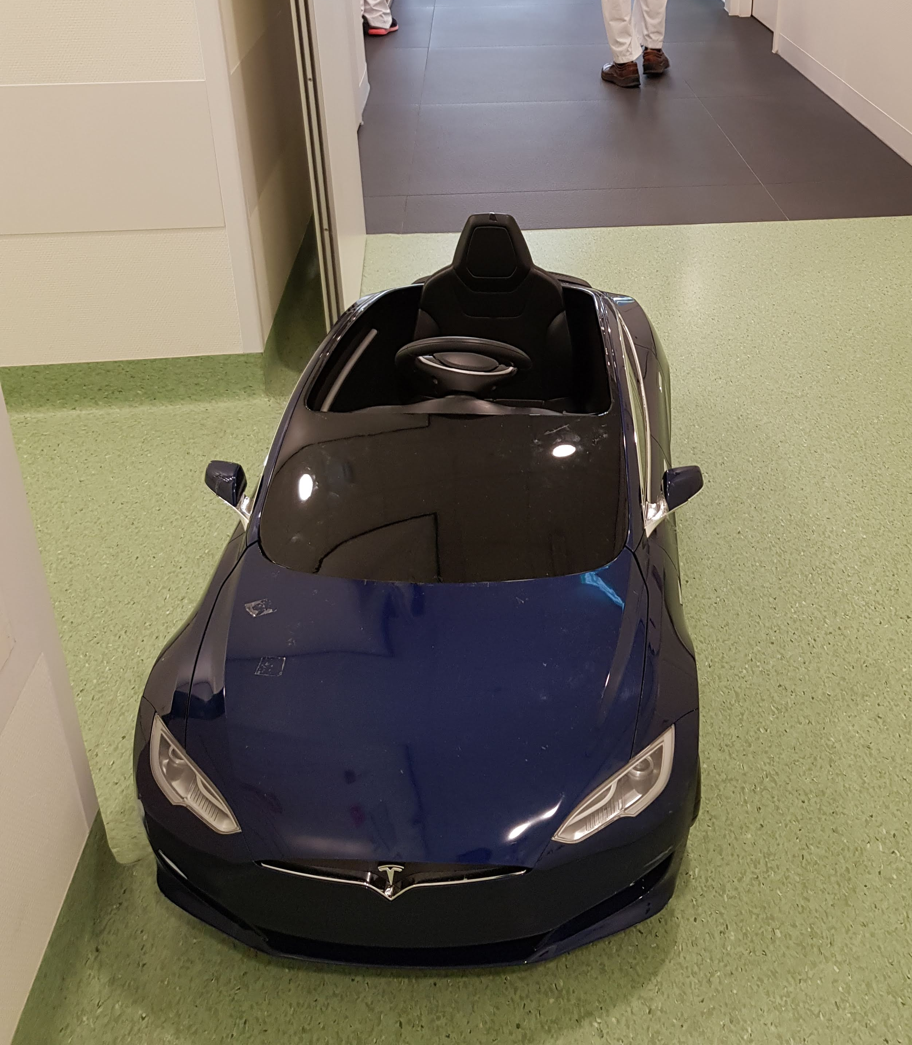
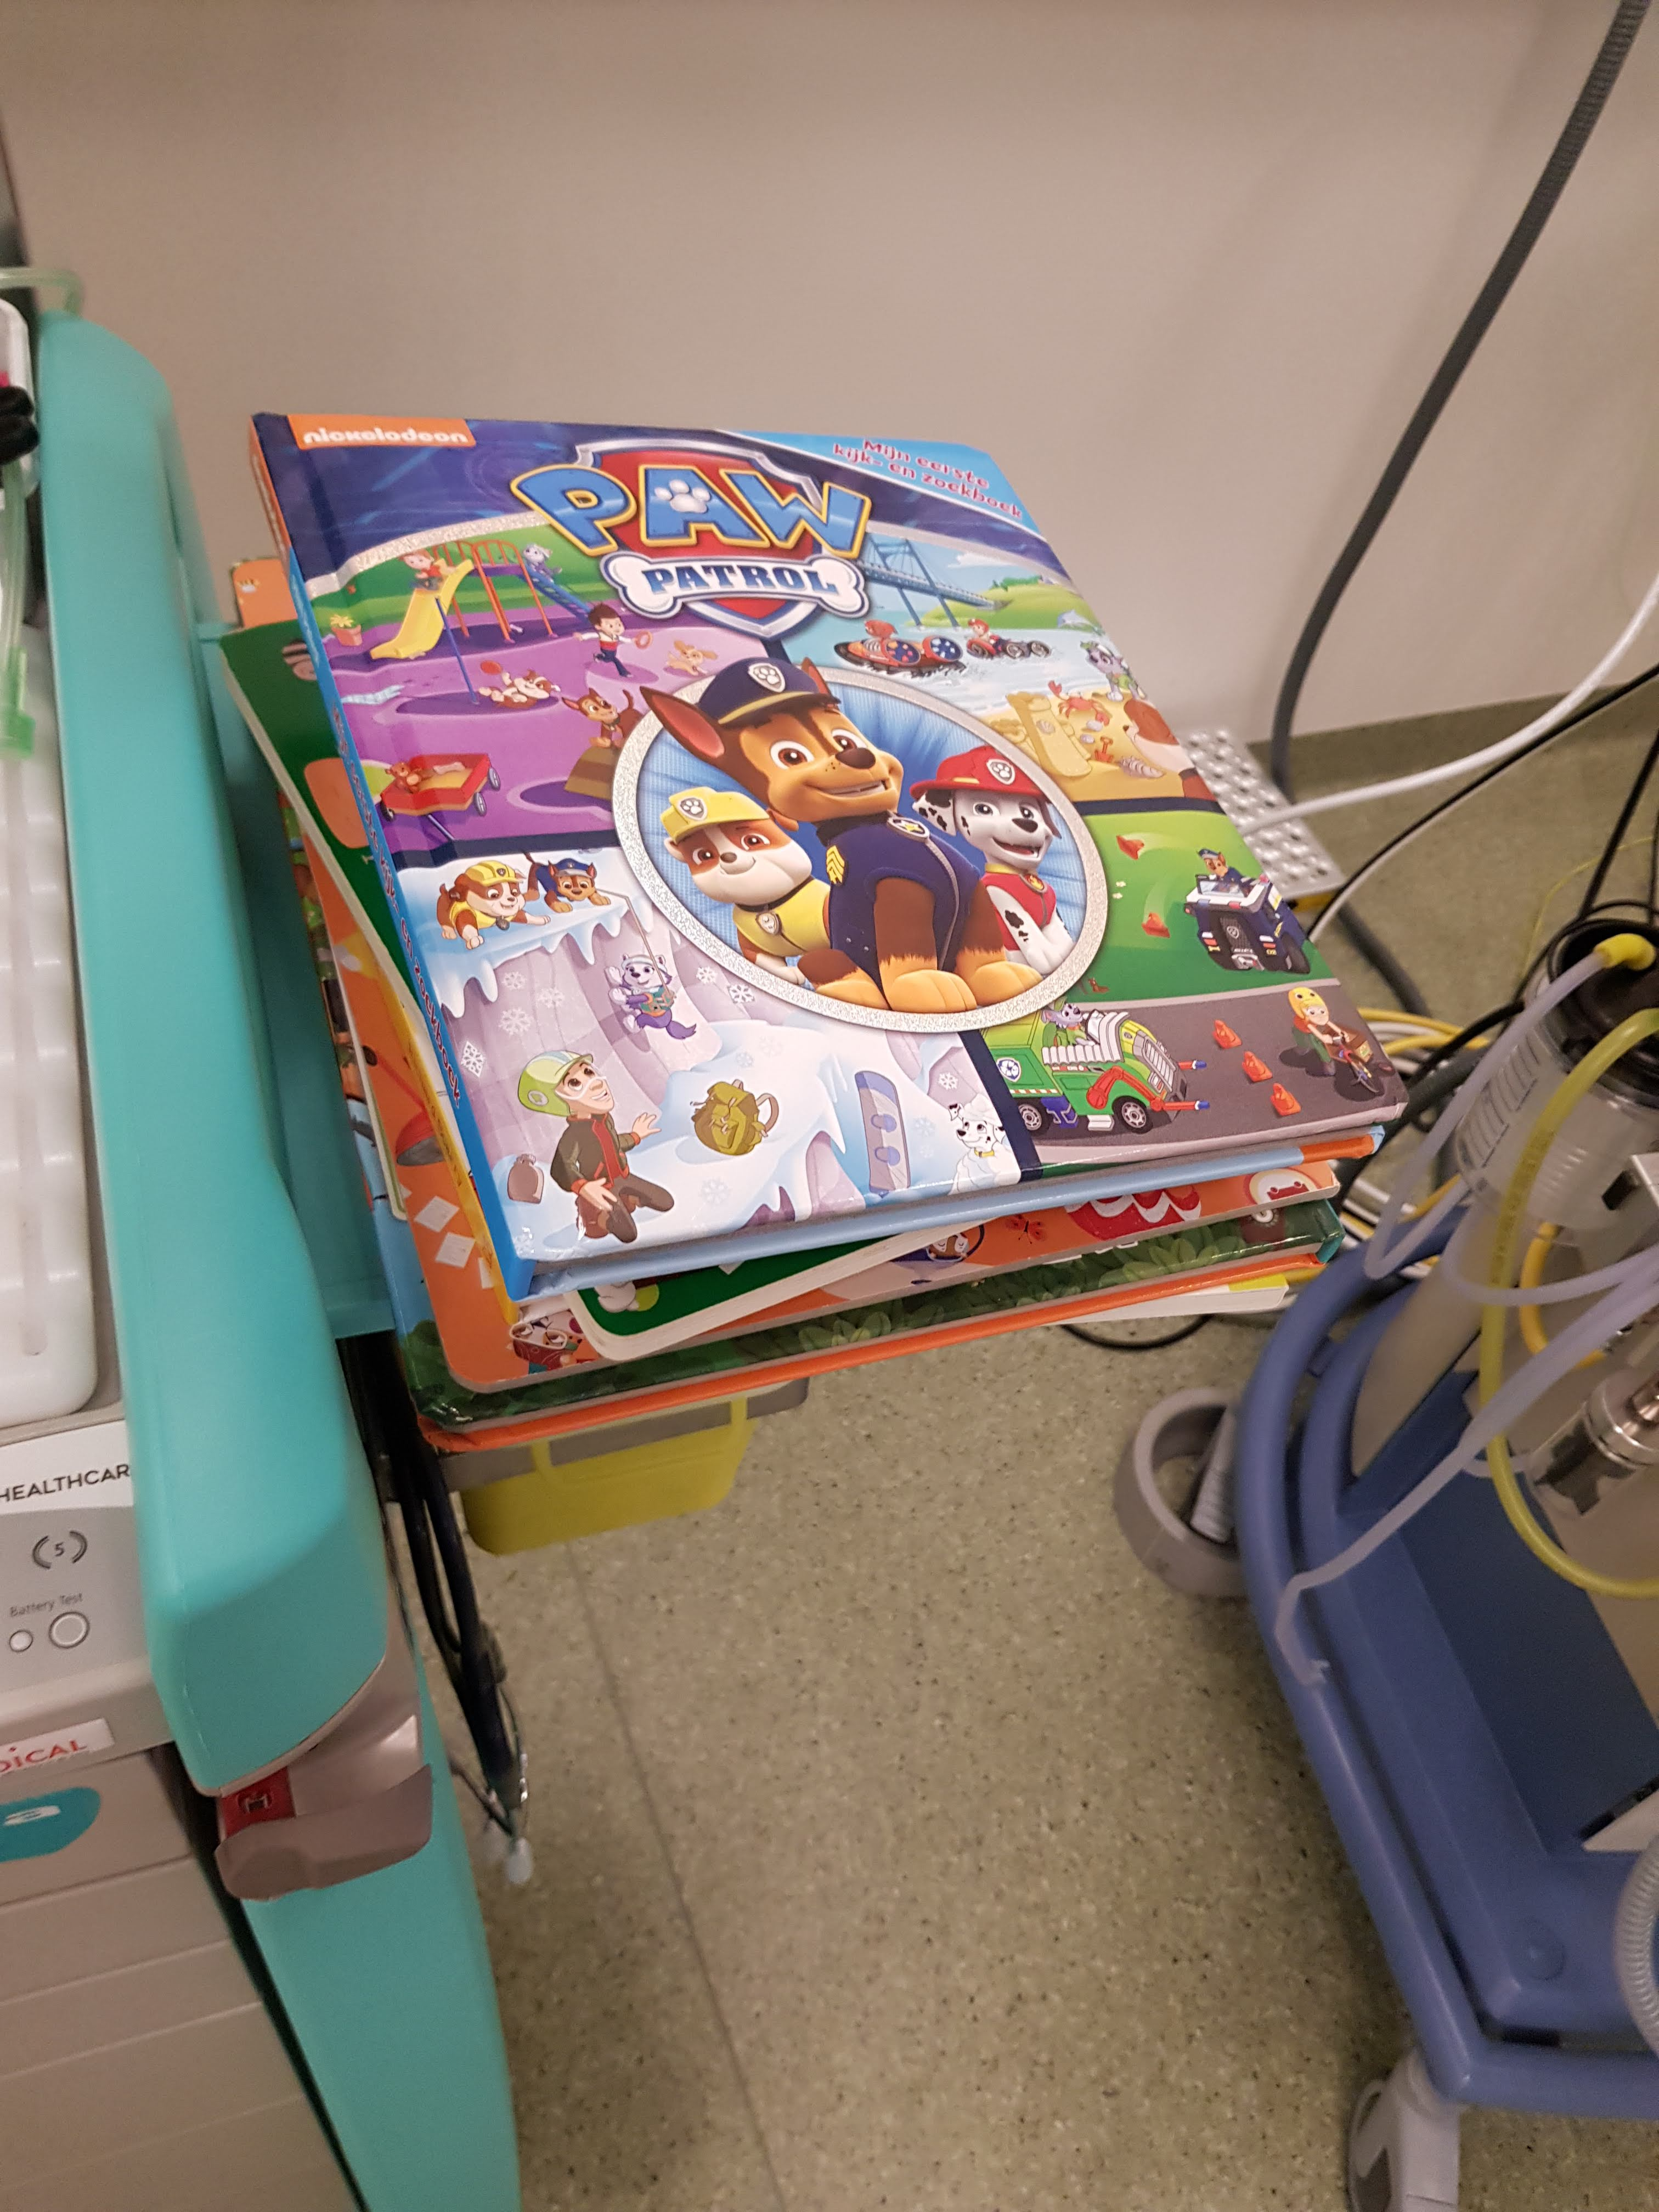
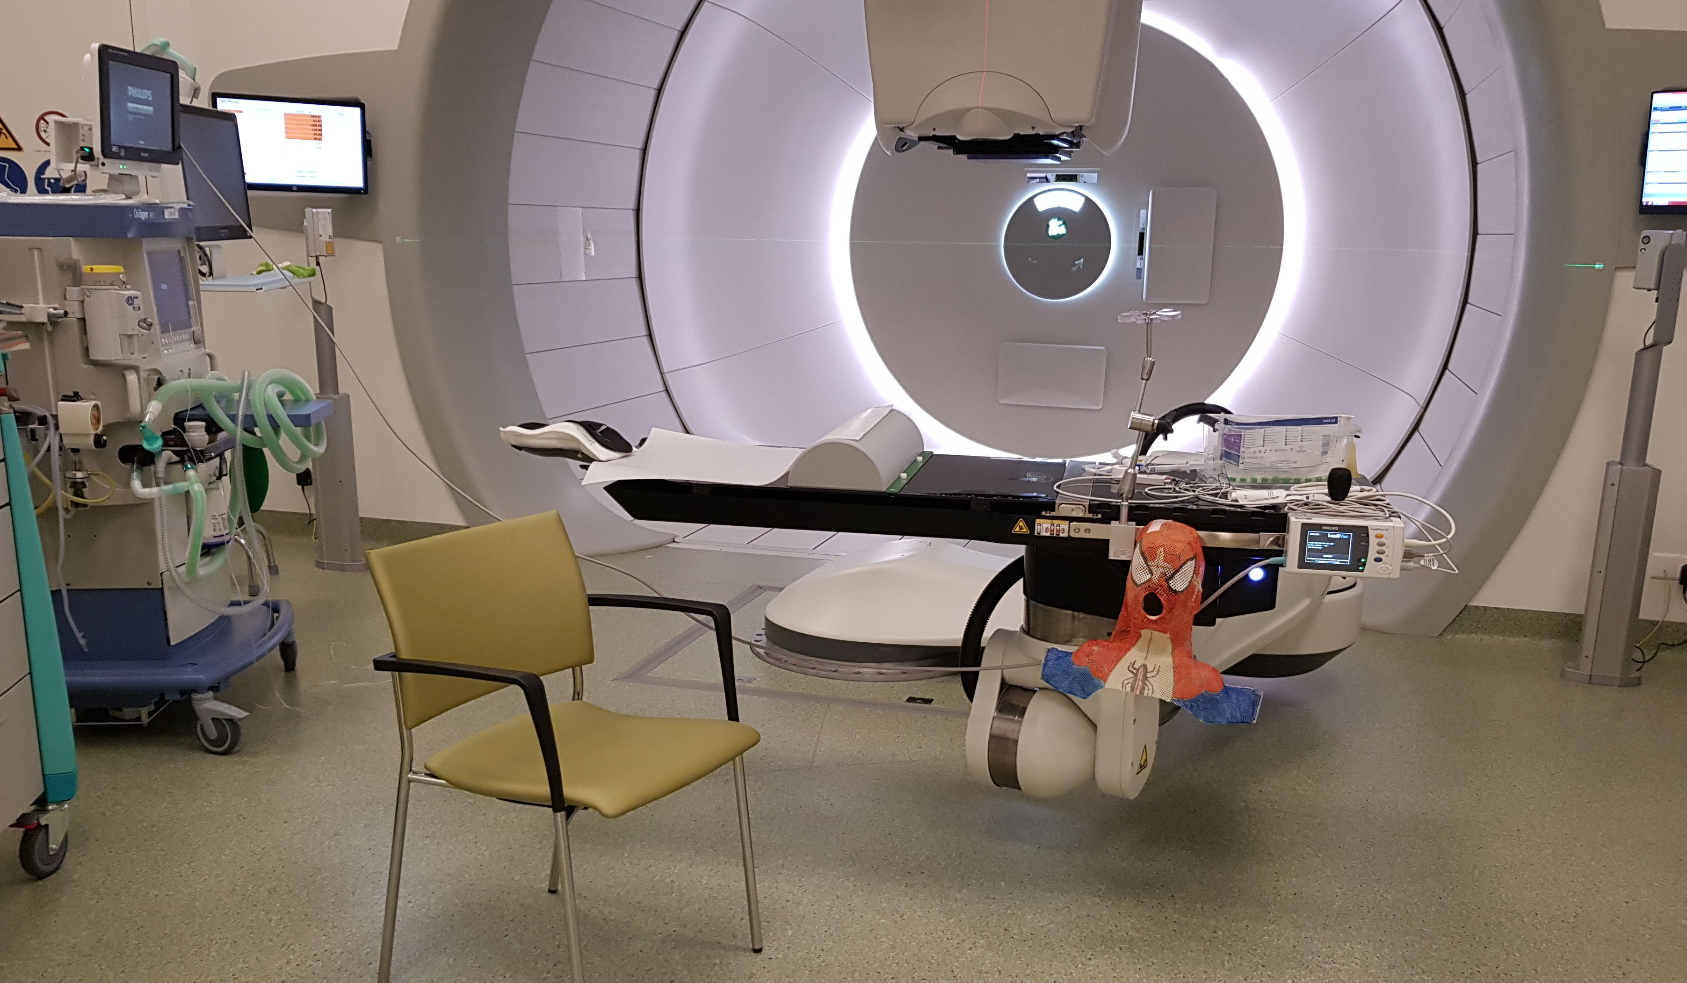
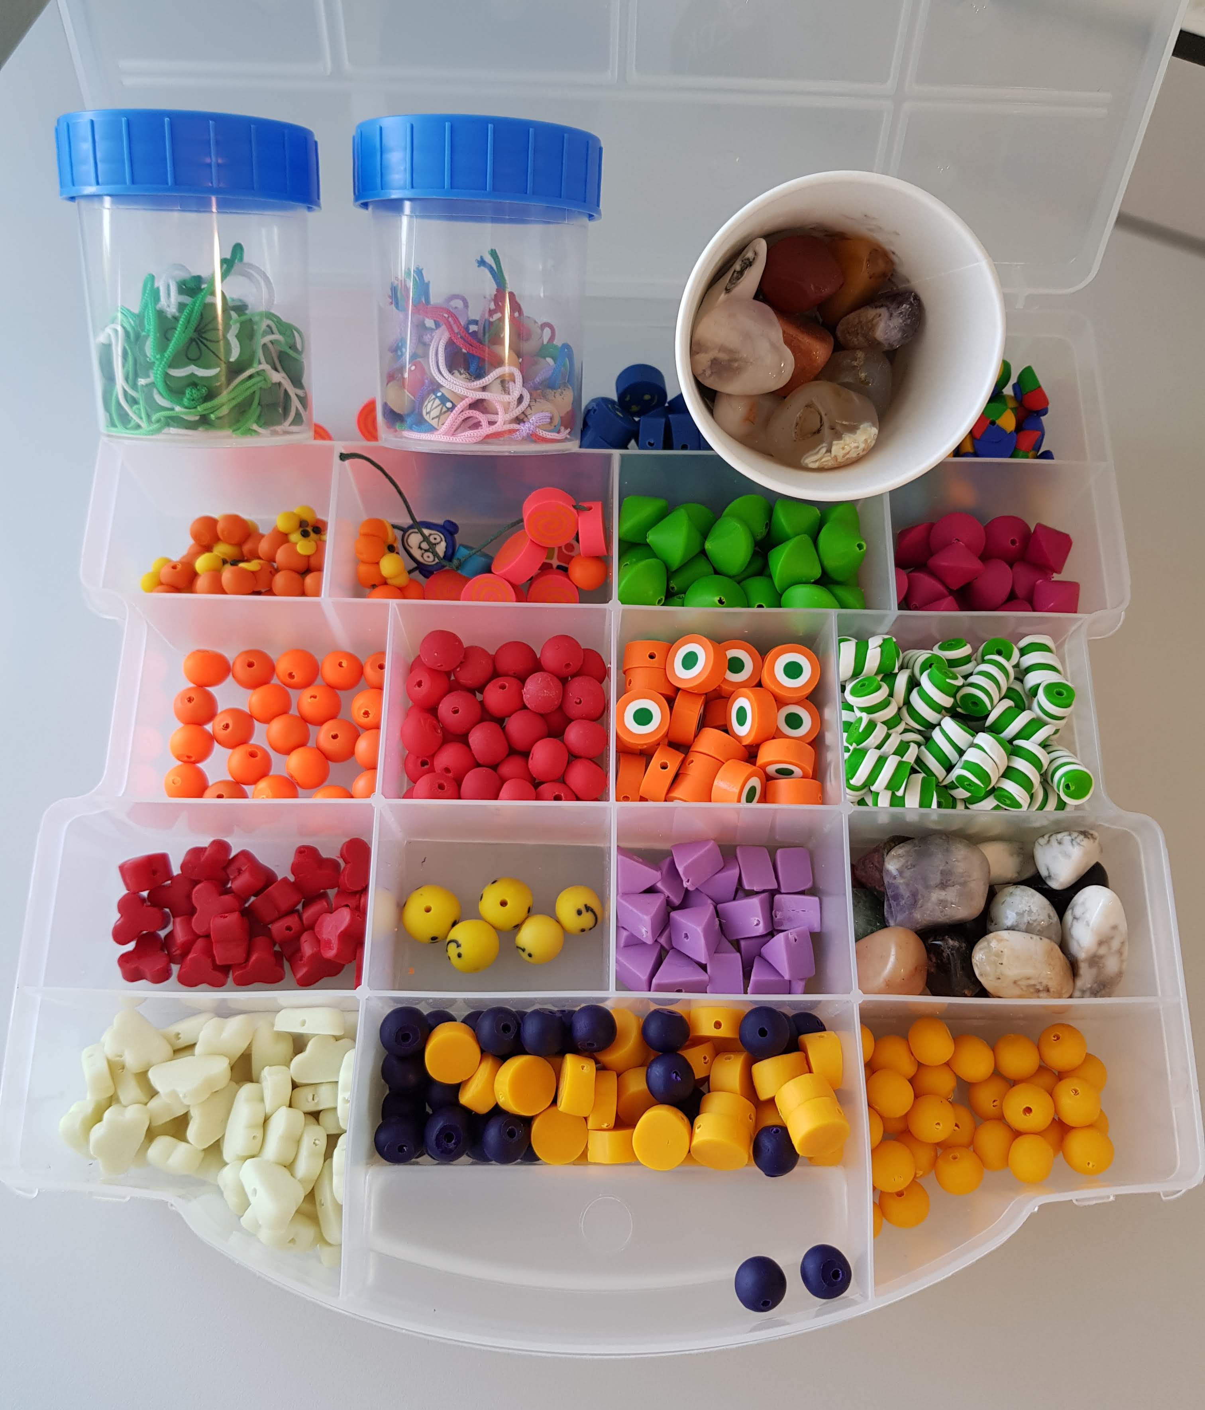
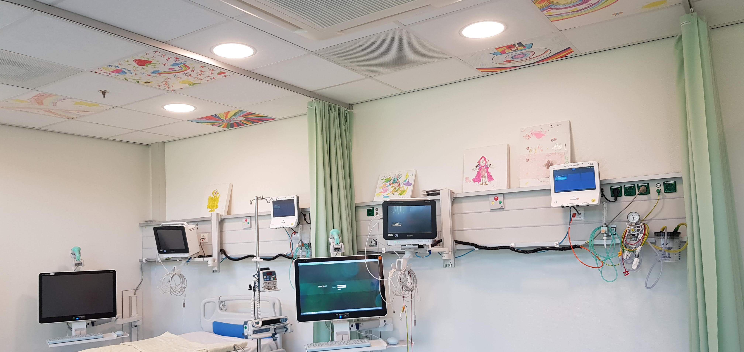
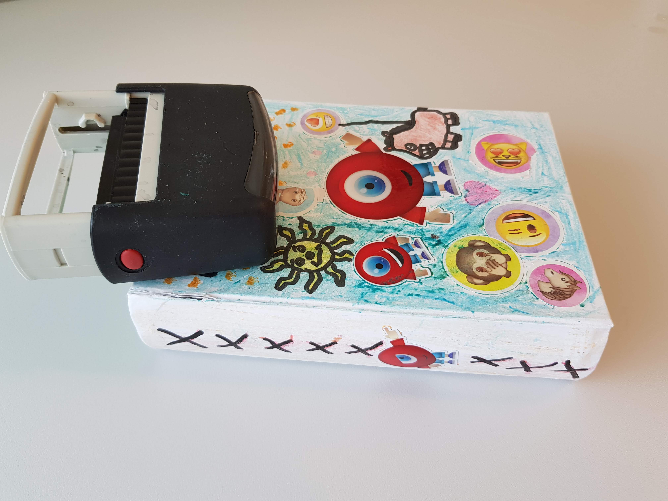
The Psychosocial Aspects in Running Paediatric Anaesthetic
Services in Paediatric Radiotherapy in a Non-Paediatric Environment
ZA Kostense , J de Ruiter
Department of Anaesthesiology, University Medical Centre Groningen, The Netherlands
Objectives
Oncology treatment including proton therapy can be stressful for both children and their immediate family. We describe our experience running the paediatric anaesthetic services for paediatric oncology patients undergoing proton therapy at the Groningen Proton Therapy Centre (GPTC) focusing on the psychosocial aspects of care.
Picture 1. Entrance to the GPTC with a special commissioned statue of a child and the waiting room where the children can play and use a touchscreen monitor to watch Youtube and play games.
Method
This is a retrospective study describing the steps taken to ensure a paediatric friendly setting in the GPTC since it is in operation from January 2018. This is the only proton centre in the Netherlands dedicated to paediatric oncology patients and offers general anaesthetic facilities. The GPTC is a purposed built building designed for proton therapy for both adults and children
Picture 2. The “Tesla” electric car which can be driven from the waiting area to the proton therapy room parked next to the anaesthetic trolley.
Results
The department of anaesthesia and radiotherapy have contributed to the design in creating a paediatric friendly environment for patients and the family during their treatment at the GPTC. The anaesthetic personnel working at the GPTC are a selected group to ensure good rapport and familiarity with the environment, patient and family. An anaesthetic-radiotherapy ritual is set up as a daily routine for the children. This includes looking for Radio Robbie the GPTC superhero, reading a book during preparation and anaesthetic induction and driving an electric toy car once a week. All would receive a self-personalised box which contained memorabilia during their treatment such as milestone achievement keepsake. They receive a stamp after each session and “strength” bead for each procedure they undergo. Parents are encouraged to interact directly with the staff allowing them to express their feelings and concerns which are directly feedback to relevant individuals via electronic messaging.
Picture 3. From looking for Radio Robbie to books, the general anaesthesia set up in the proton therapy room. Hanging here is a painted mask drawn by our radiotherapist, requested by the child.
Picture 4. End of session where special oncology strength beads are given out placed in the child’s memorabilia box in the specially paediatric designed recovery room after waking up from general anaesthesia.
Conclusion
The prospect of daily anaesthesia and radiotherapy in an unfamiliar place for a child in a non-paediatric environment can be daunting. We had successfully created a safe and paediatric friendly setting for the patient and their family.
Conflict of Interest
None

